Slide 1
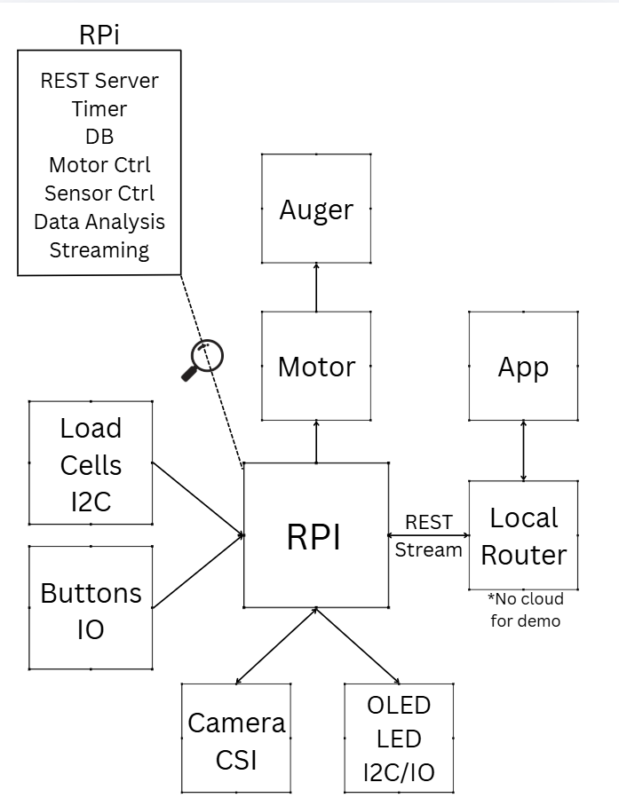
PawStation

Slide 2
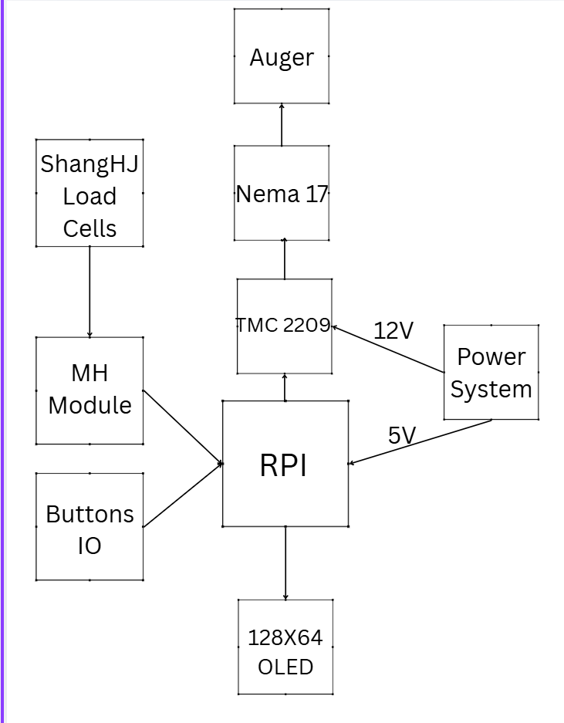
Overview
Display Driver

Slide 3
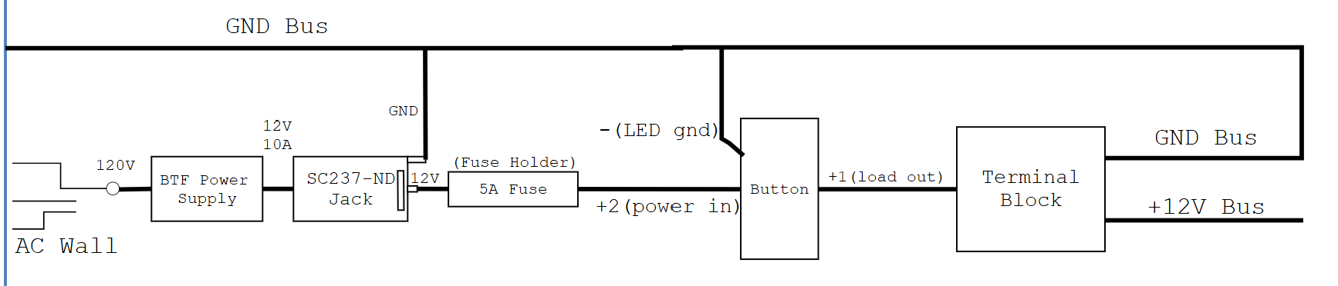
Power System
Provide 12V

Slide 4
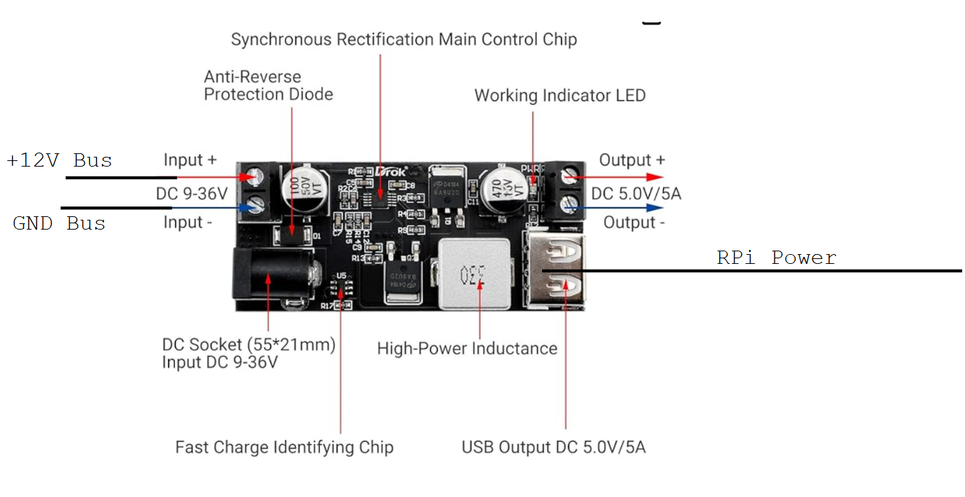
Buck Converter
Make into 5V for Pi

Slide 5
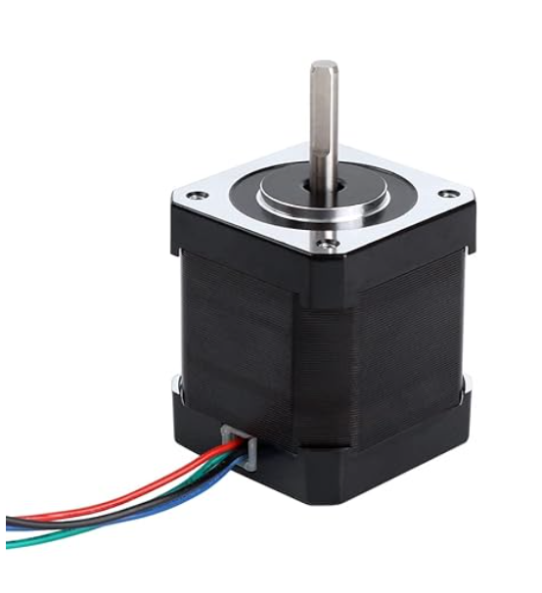
NEMA 17
TMC2209

Slide 6
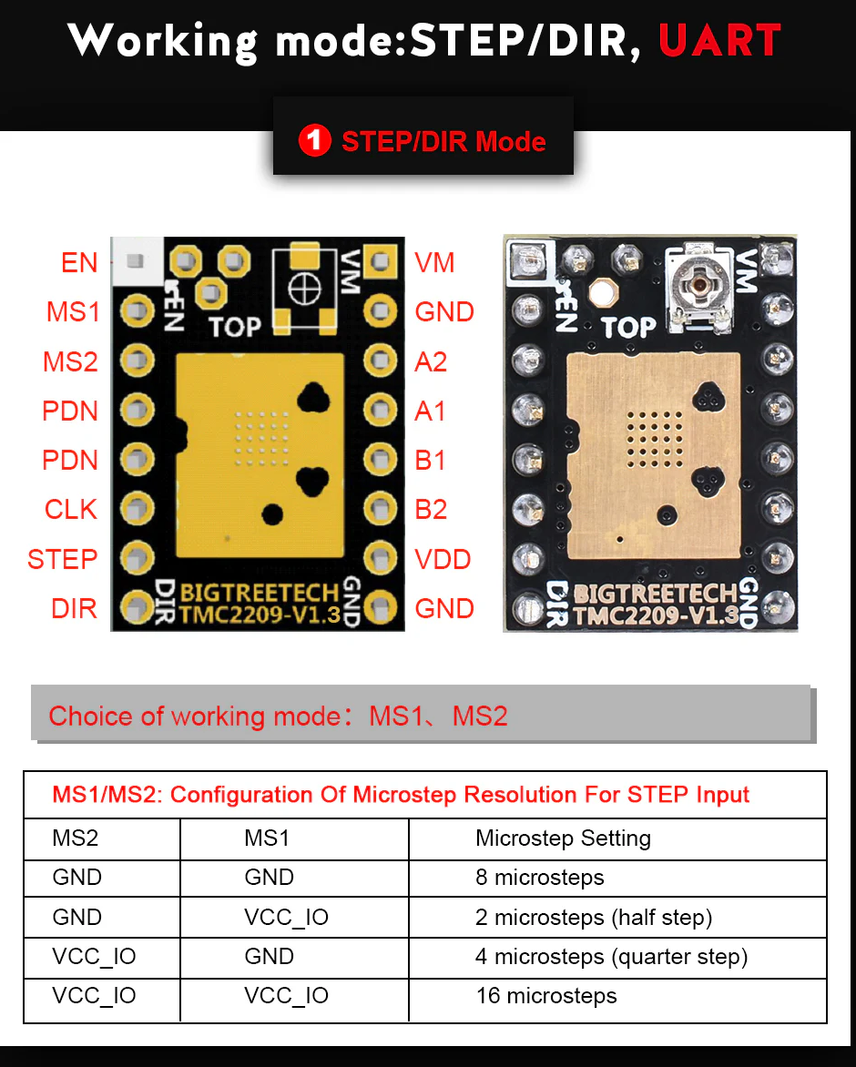
TMC2209 Motor Driver
https://biqu.equipment/products/bigtreetech-tmc2209-stepper-motor-driver-for-3d-printer-board-vs-tmc2208

Slide 7
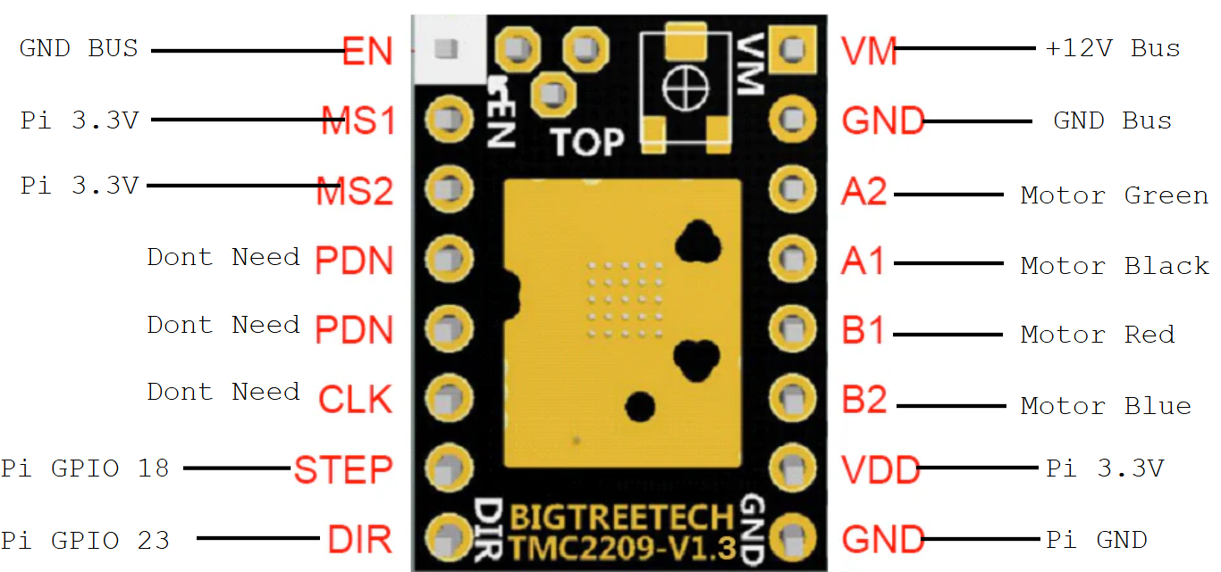
TMC2209

Slide 8
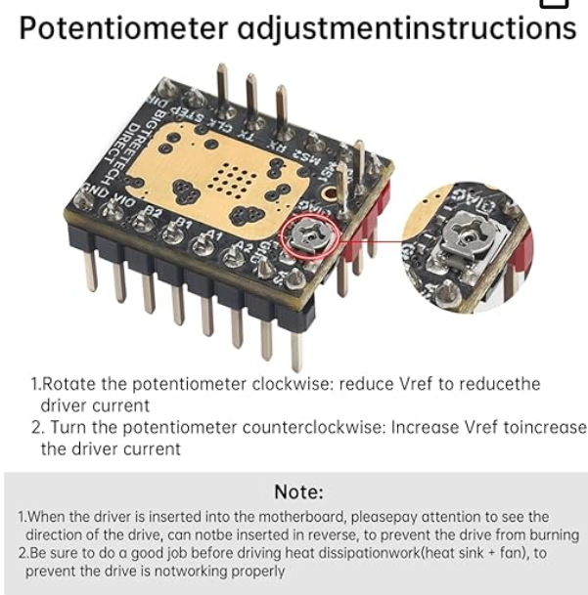
TMC2209
Most StepStick-style boards set current with a tiny potentiometer (Vref trim pot).
So you:
Power the driver (VMOT on, logic on)
Measure Vref at the test pad / potentiometer wiper
Turn pot slightly until Vref corresponds to desired current
Our motor is 2A max, so calibrate to 1~1.5A

Slide 9
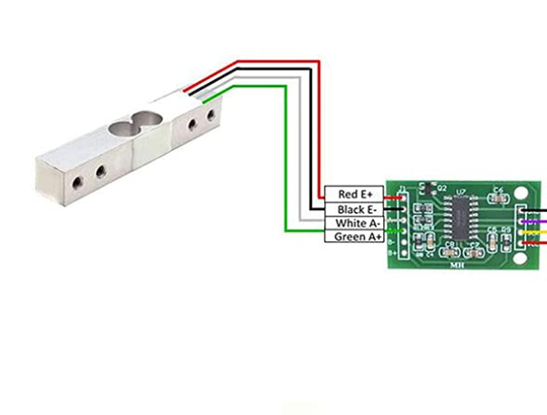
MH(Load Cell Module)

Slide 10
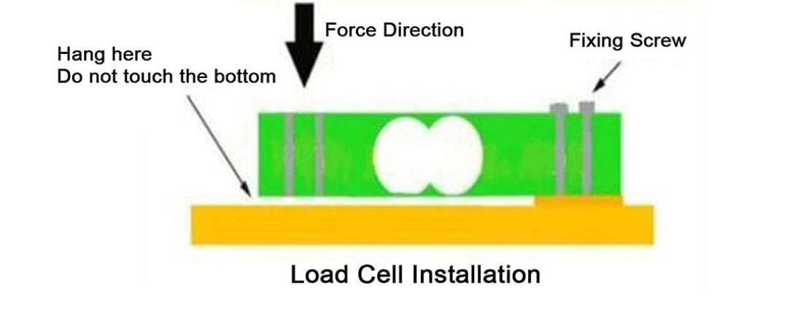
MH

Slide 11
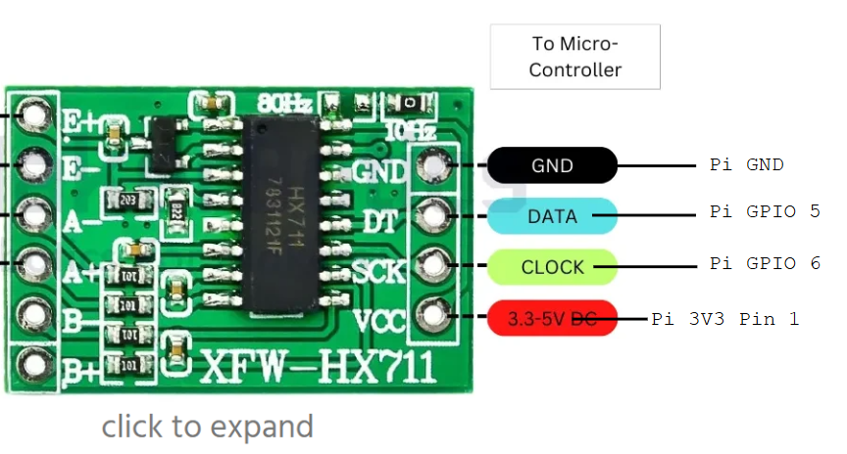
MH

Slide 12
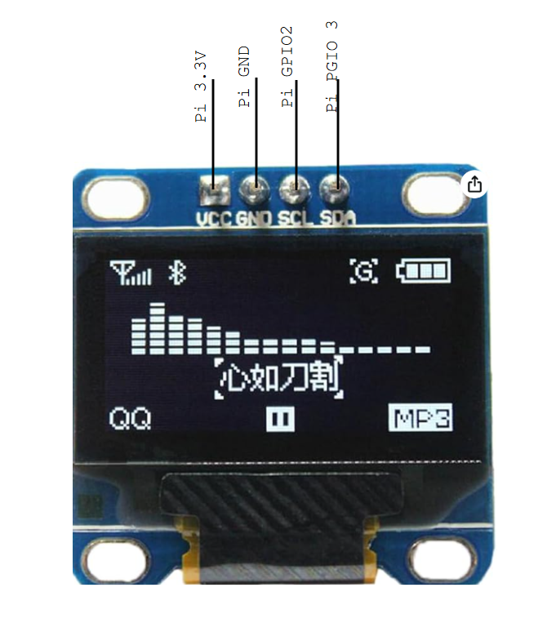
Display Unit

Slide 13
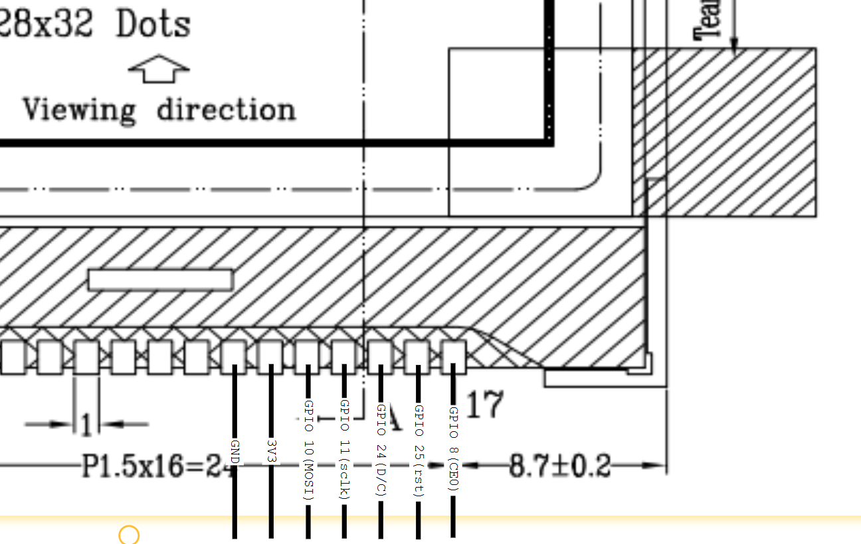
NHD-C12832A1Z

Slide 14
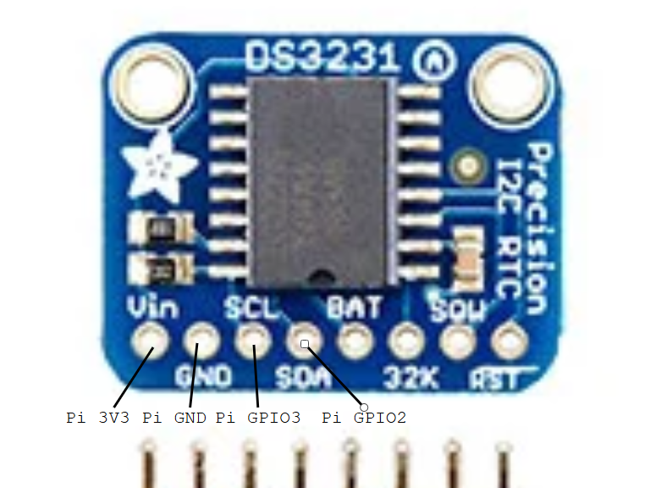
RTC

Slide 15
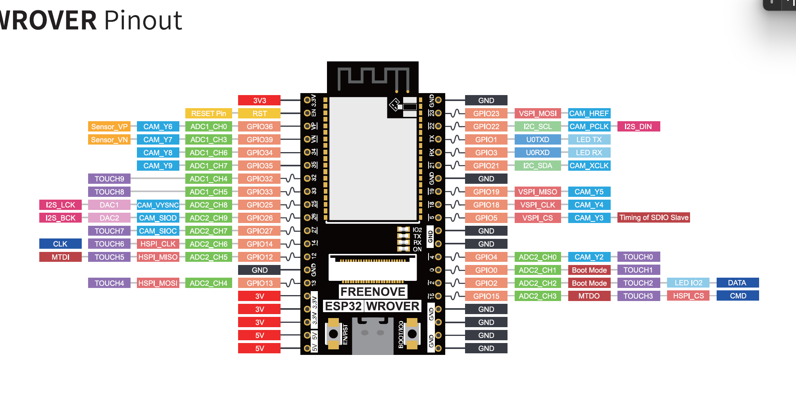
Camera

Slide 16
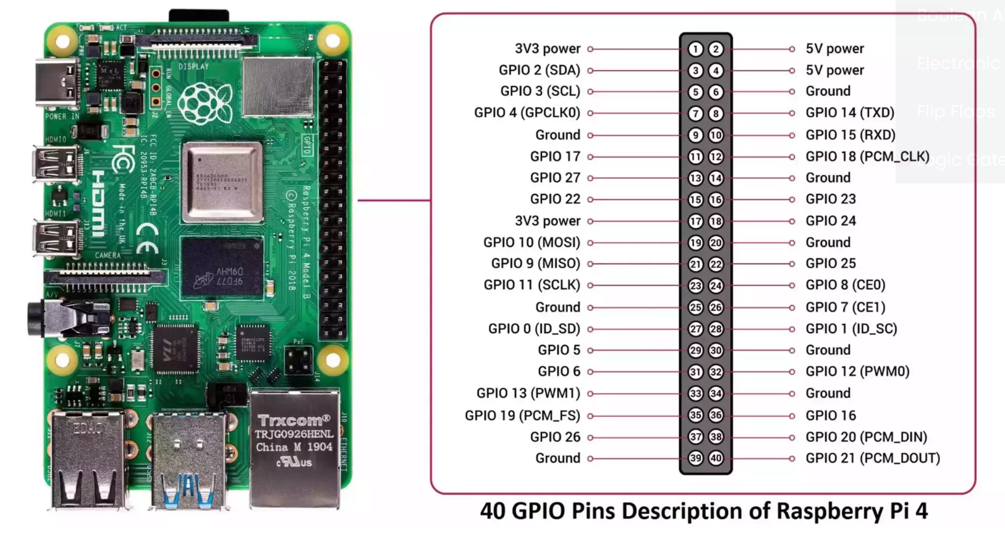
RPi

Slide 17
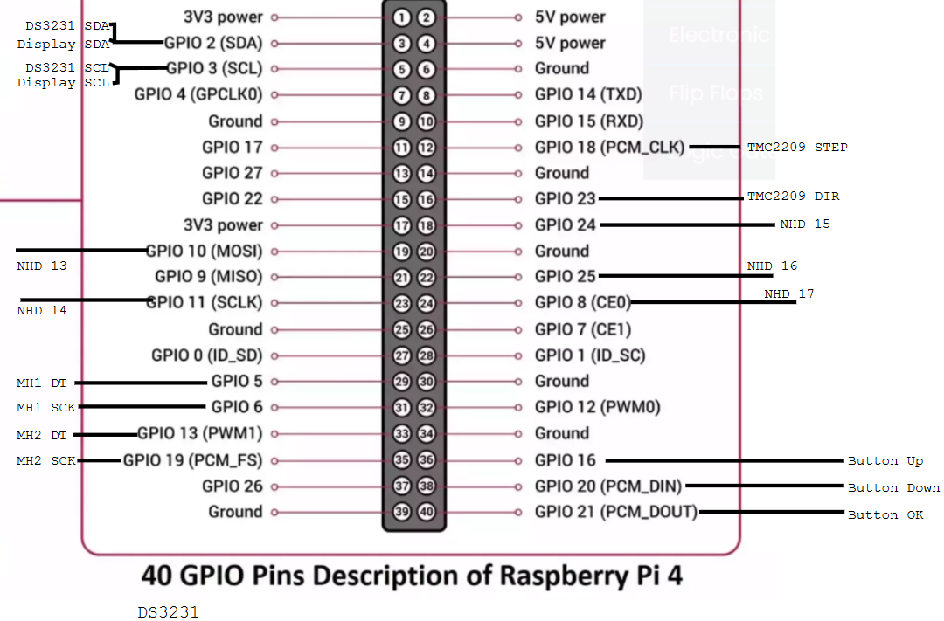
RPi

